Slide 1
The Adventure of the Stockbroker’s Clerk
Brief Analysis
Presented by Brian Clark
with support from Christina Hicks and Michael Coulter

Slide 2
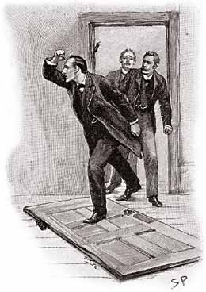
Contents
Publication Notes & Adaptations
Contextualization
Canonical Comparisons
Unique devices and elements

Slide 3
Publication Notes & Adaptation
Published in 1894 as Adventure #3 in the 11-chapter American versions of The Memoirs of Sherlock Holmes; it’s #4 in modern British editions
“The Adventure of the Cardboard Box” was #2 in Memoirs per the Strand publication chronology (1893); Conan Doyle thought it unsuitable for minors (adultery!) and withheld it from the British edition, and the first American edition was quickly revised to remove it. Most modern American compilations still include CARD as #2 in His Last Bow.
STOC was dramatised for BBC Radio 4 in 1992
The HBO series “Miss Sherlock” loosely adapted STOC for a 2018 episode called "Lily of the Valley" wherein a character is offered a spurious research pharmaceutical research position.
1922 silent film starring Eille Norwood as Sherlock Holmes
STOC was NOT included in the Jeremy Brett series

Slide 4
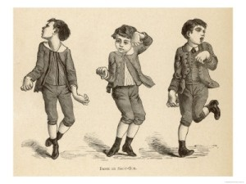
Contextualization: St. Vitus’ Dance
A variant of chorea (not cholera!) technically known as Sydenham chorea after the 17th century English doctor who explained it, Thomas Sydenham. Also known as chorea minor, infectious chorea, and rheumatic chorea.
A neurological disorder that causes uncontrollable spasms, particularly in the face and upper extremities.
Usually follows a streptococcal infection, often a symptom of rheumatic fever; caused by a bacterial infection, easily cured by antibiotics.
Generally affects children, more frequently girls than boys - rarely affects adults.
Did Doyle know this? Literary license?

Slide 5
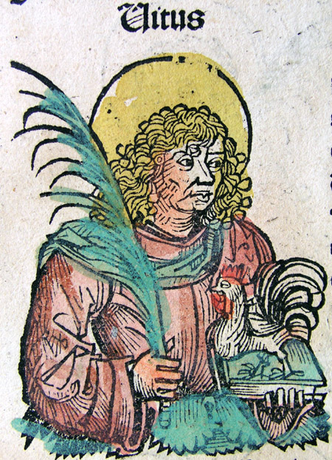
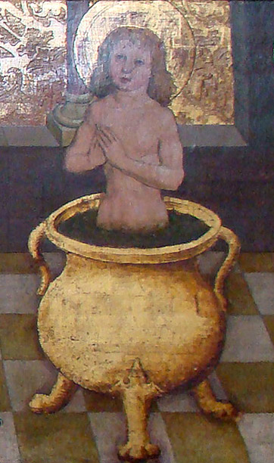
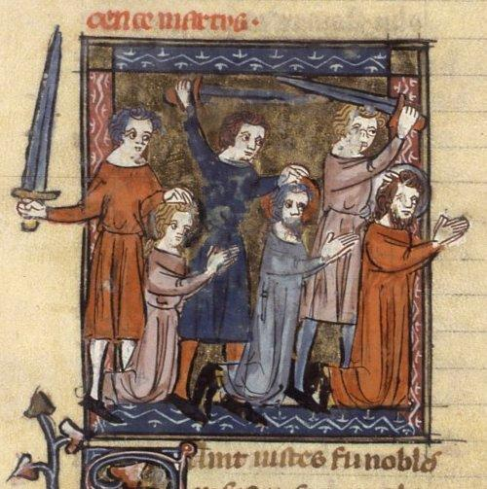
Contextualization: St. Vitus
According to legend, Vitus was a Sicilian martyred by the Roman Emperor Diocletian circa 300 A.D., aged either 7 or 12, after he ‘cured’ the Emperor's son of epilepsy by driving out a demon, but then failed to credit the appropriate pagan deities.
Vitus is the patron saint of epileptics, as well as dancers, as well as actors and comedians. Also: he protects against oversleeping, wild animal attacks, and lightning strikes.
Saint Vitus' Day is celebrated on 15th June (Julian) or 28th June (Gregorian). In various Westphalian (read: German) towns, celebrations of his feast day included dancing around his statue.
Epilepsy <> dancing <> Sydenham chorea ?

Slide 6
Contextualization: The Van Francis Method
“It has been touch and go with him,” said I, “but he’ll live now. Just open that window, and hand me the water carafe.” I undid his collar, poured the cold water over his face, and raised and sank his arms until he drew a long, natural breath. “It’s only a question of time now,” said I, as I turned away from him.
This might be a Victorian-era approach to resuscitation known as the Van Francis Method, described in a presentation made to the International Aquatic History Symposium and Film Festival of 2012 (see HERE) : “In 1886 AD, the Van Francis resuscitation method was established. The casualty was placed in a supine position along the middle of a piece of wood and his arms were extended upwards. The two sides of the wood were raised alternately to stimulate inhalation and then lowered to stimulate exhalation.”
Short version, Van Francis not included: CPR through History

Slide 7
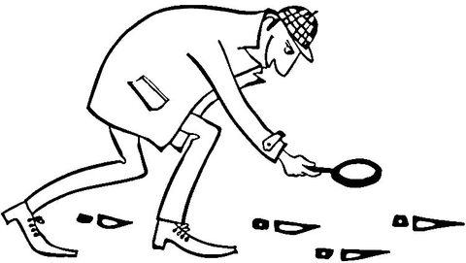
Canonical Comparisons: Amazing Watson
The Adventure of the Stockbroker’s Clerk starts with the usual ‘fantastic feat of deduction’ that amazes Watson
Slippers, this time - scorched, yet neither old nor worn
How many other times was Watson stunned by shoe-related deductions?
Scandal in Bohemia: deduction of Watson’s activity by scrapes on his left shoe
Crooked Man: Watson’s boots are used, but not dirty - he’s busy enough to hire a hansom;
Also, he’s had a British workman in the house, “a token of evil.” (nail marks on the linoleum)
Lady Frances Carfax: odd lacing on Watson’s boots = he’s been to a Turkish bath

Slide 8
Canonical Comparisons: footwear deductions
Study in Scarlet: “Patent-leather boots had gone round [the puddle], and Square-toes had hopped over.”
Case of Identify: mismatched ladies’ boots, half-buttoned
Boscombe Valley: “Tiptoes! tiptoes! Square, too, quite unusual boots! They come, they go, they come again—”
Beryl Coronet: ““There was a double line of tracks of a booted man, and a second double line which I saw with delight belonged to a man with naked feet.”
Silver Blaze: multiple matchings of boots and horseshoes
Hound: two individual boots gone missing; one returned, one found
Resident Patient: square-toed instead of pointed
Priory School: more horseshoes (old shoes, but new nails; shaped like cows’ feet)
Three Students: scratches on a table caused by running shoes with spikes
Valley of Fear: “...remarkably broad; a splay-foot, one would say”
Wisteria Lodge: “...a number twelve shoe, I should say. If he was all on the same scale as his foot he must certainly have been a giant.”
Devil’s Foot: “You were wearing, I may remark, the same pair of ribbed tennis shoes which are at the present moment upon your feet.”

Slide 9
Canonical Comparisons: similarities to other stories
The Red-Haired League (1891-1892)
A phony job offer intended to lure an ‘inconvenient person’ away from criminal activity
London in REDH versus Birmingham in STOC
Although Holmes had already solved the mystery before they left London??
Hall Pycroft realizes that something is off in STOC; Jabez Wilson in REDH did not
The Adventure of the Three Garridebs (1924)
Birmingham again
Also involves a newspaper advertisement intended to lure someone away
Somebody was murdered - the unfortunate watchman
Full canon: 263 dead bodies; 119 murders
Adventures: only four of the twelve stories in have anything to do with murder (source)
James Bond movies: 1,352 deaths, 407 by Bond; averages 59 and 16, respectively
(source, source)

Slide 10
Unique Devices and Elements
Is this the only place in the Canon where we’re told anything about the voice of Sherlock Holmes?
“...as I sat reading the British Medical Journal after breakfast, I heard a ring at the bell, followed by the high, somewhat strident tones of my old companion’s voice.”
(Hall) Pycroft...it’s awfully close to “Mycroft”, isn’t it?

Slide 11
What did you observe?

