Slide 1
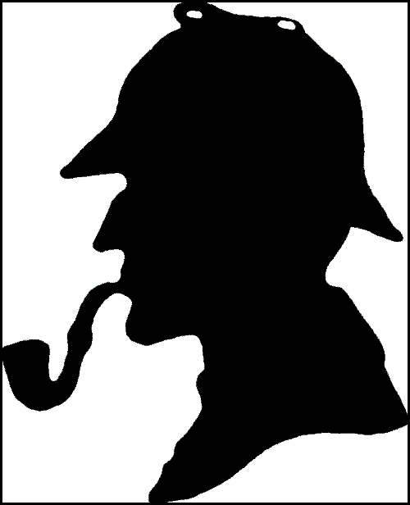
The True adventures of
Sherlock holmes
& Wine:
A Canonical
Decanting

Slide 2
What wines are mentioned?
Sherry – Adventure of the Noble Bachelor, The ‘Gloria Scott’
Tokay – His Last Bow, Sign of the Four
Chianti – Sign of the Four
Montrachet – Adventure of the Veiled Lodger
Port – Sign of the Four, The ‘Gloria Scott’
Champagne –Valley of Fear, Sign of the Four
Claret – Adventure of the Cardboard Box
Beaune – Sign of the Four

Slide 3
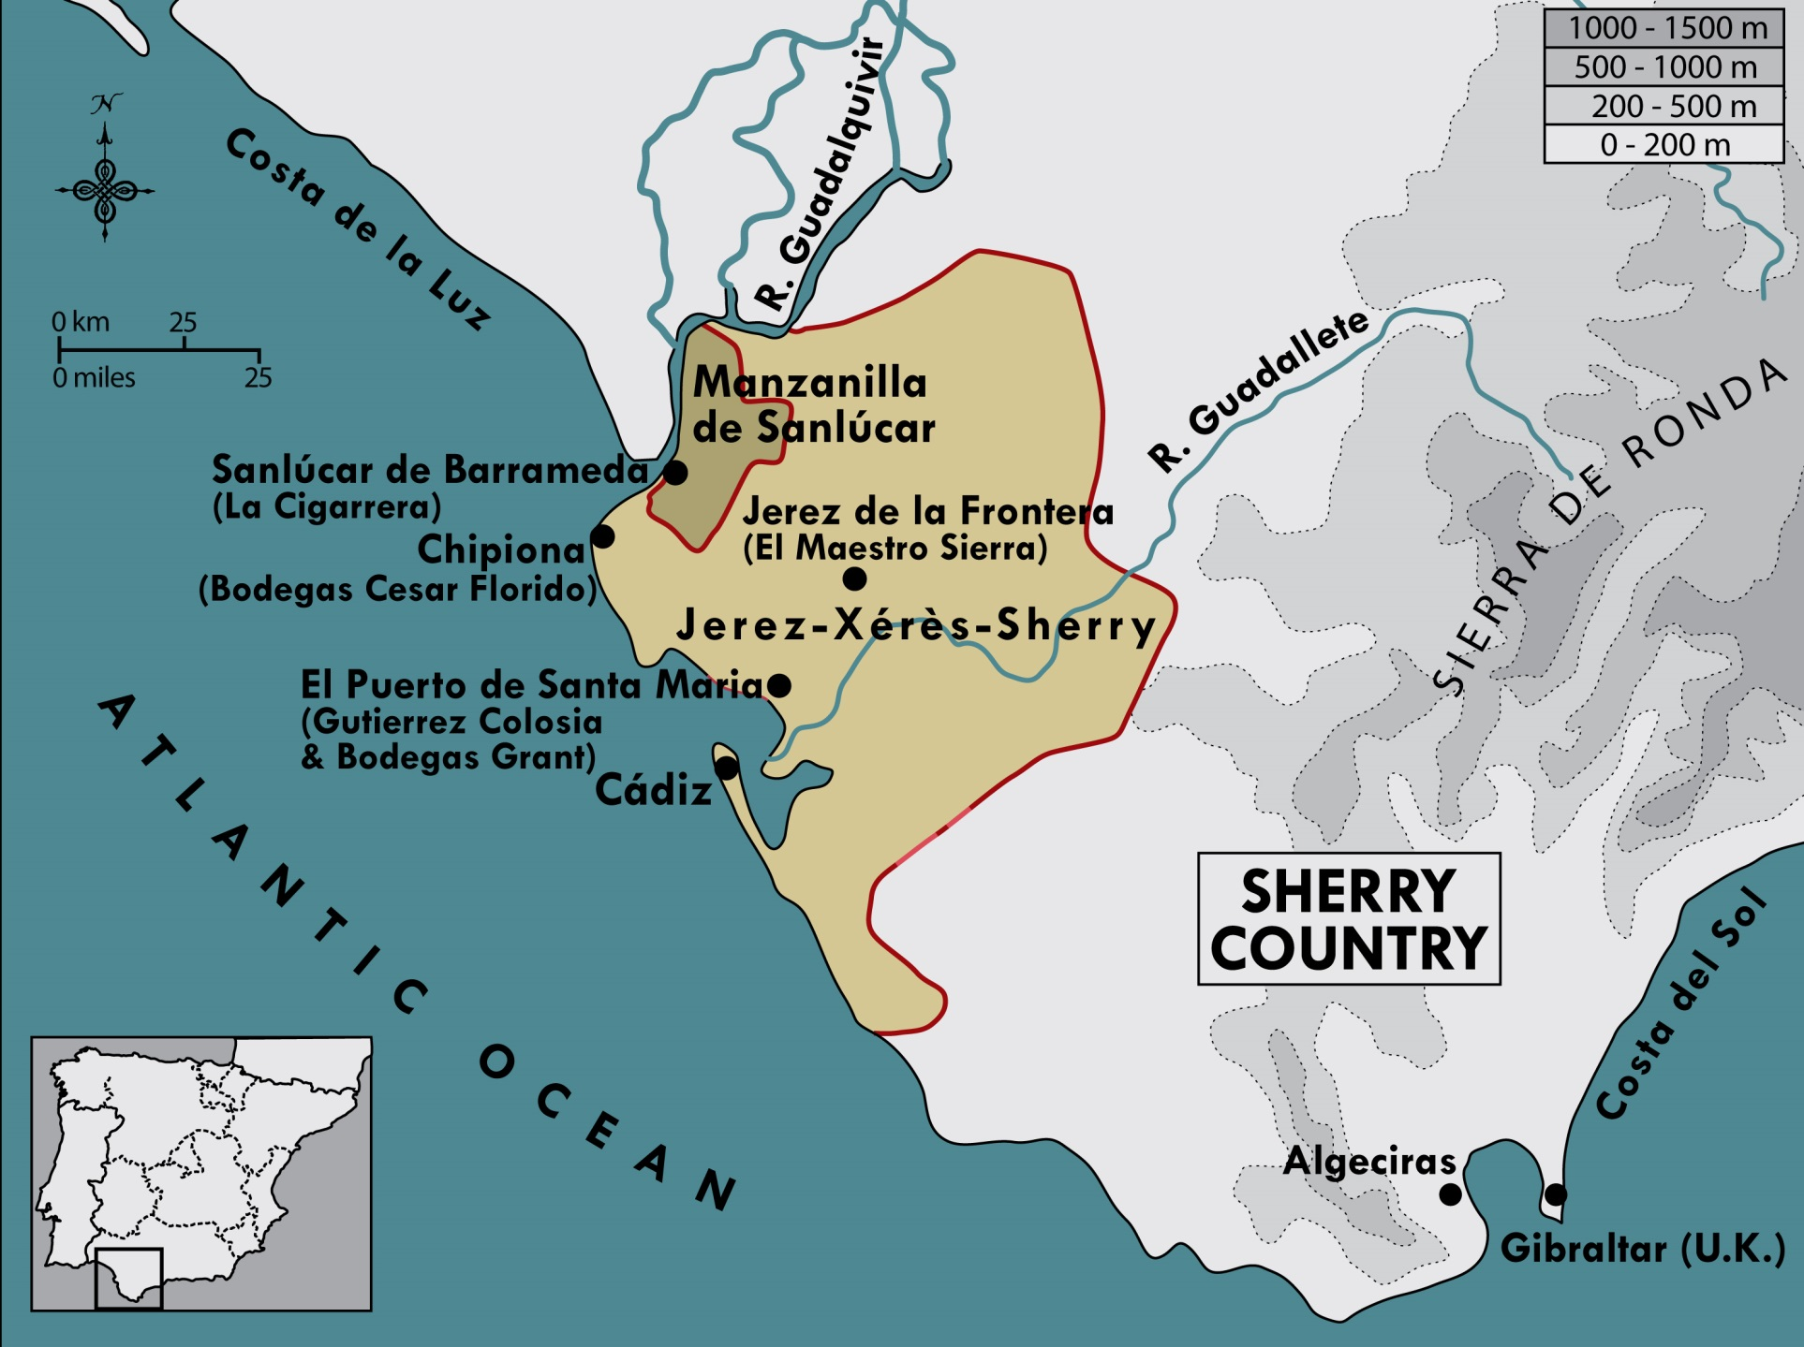

Slide 4
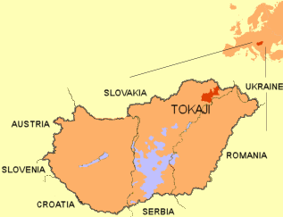

Slide 5
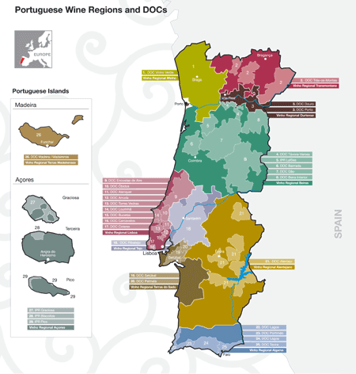

Slide 6
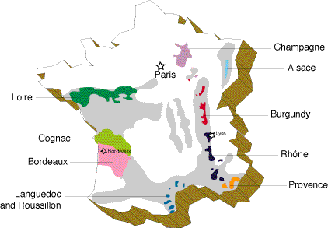

Slide 7
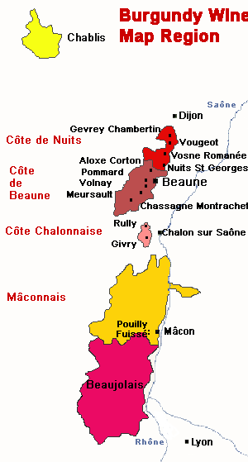

Slide 8
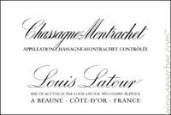
Name of Wine
Met Standards
Shipper Name
Producing Info
Mis en bouteille par …
Mis en bouteille au château (à la propriété) …

Slide 9
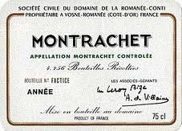

Slide 10
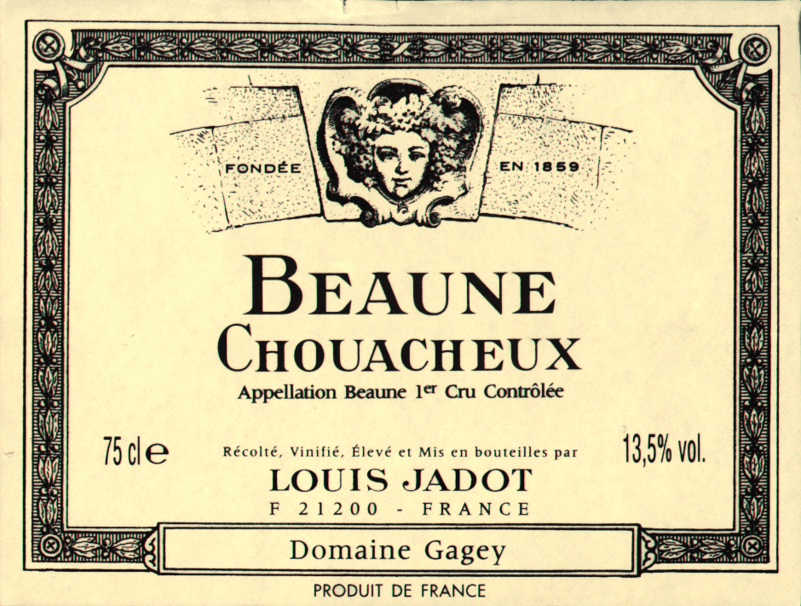
Name of Wine
Met Standards
Shipper Name
Producing Info

